Slide 1
Nassau candy sales dashboard
Data Analyst Internship Project
Presented by Priya Gupta
Tool Used:- Microsoft Power BI.

Slide 2
Project Objective & Dataset
The objective of this project is to analyze sales performance using Power BI.
The dashboard helps identify sales trends, profit, customer behavior , and product performance to support better business decision.
The dataset contains sales transaction recording, including Order ID, Order Date, Ship Date, Customer ID, Product Name, Category, Sales, Profit, Quantity, State, Region and Shipping details .

Slide 3
Data preparation
The dataset was prepared using Power Query in Power BI. Duplicate records were removed, data types were corrected, and missing values were handled. A new column, Shipping Lead Time, was created by calculating the difference between Ship Date and Order Date. After cleaning and transforming the data, the dataset was loaded into Power BI for further analysis and visualization.

Slide 4
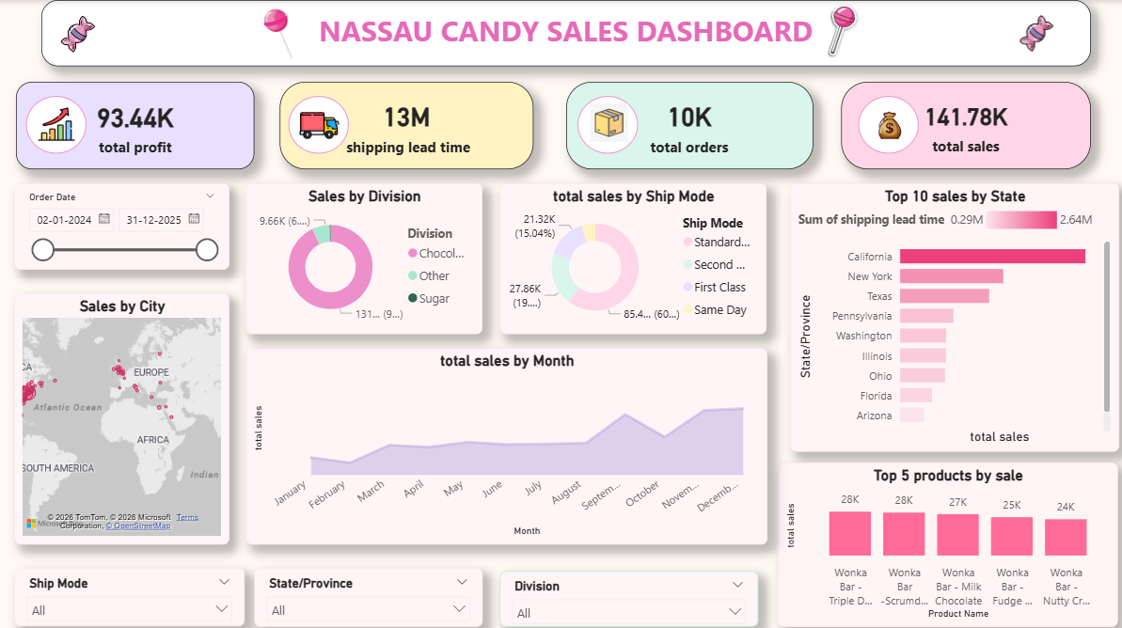
Dashboard overview

Slide 5
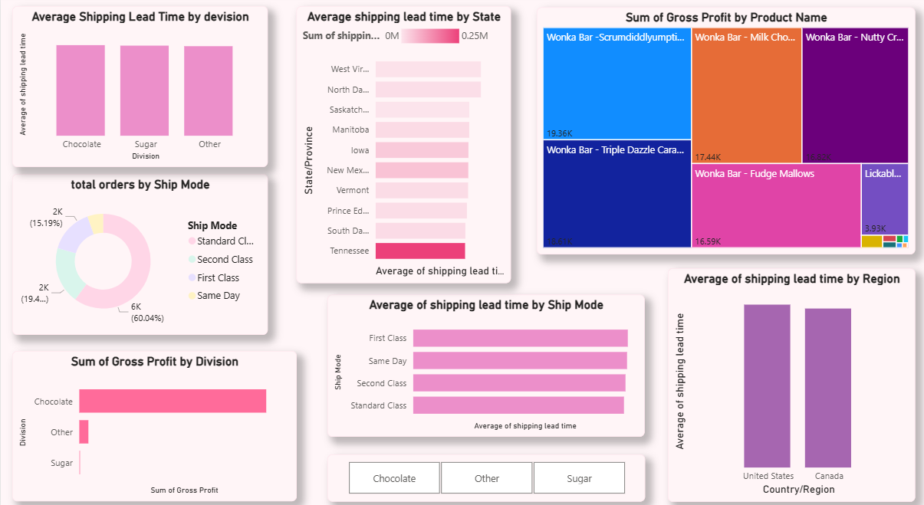
Product and Shipping Analysis

Slide 6
Conclusion
This project successfully demonstrates how Power BI can be used to analyze and visualize e-commerce sales data. By cleaning the data, creating DAX measures, and building an interactive dashboard, valuable business insights were obtained. The dashboard helps in monitoring sales performance, identifying trends, and supporting data-driven decision-making.

